Slide 1
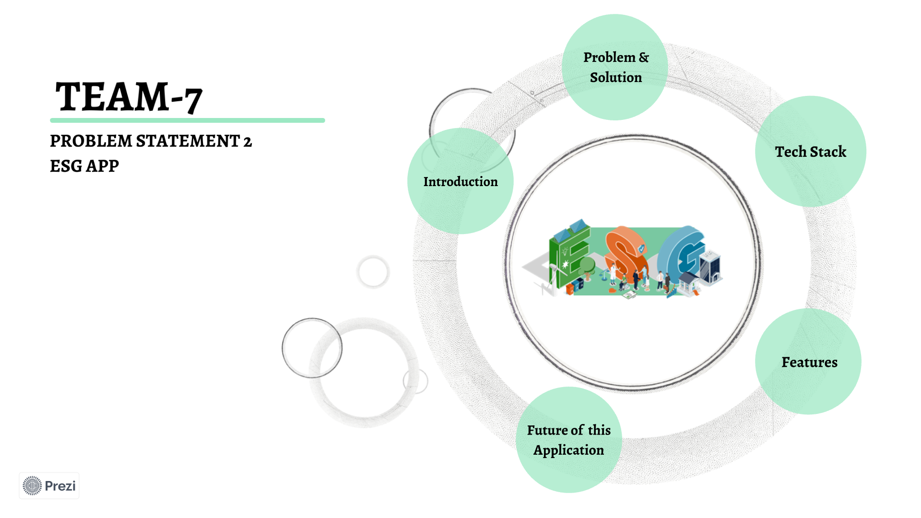
TEAM-7

Slide 2
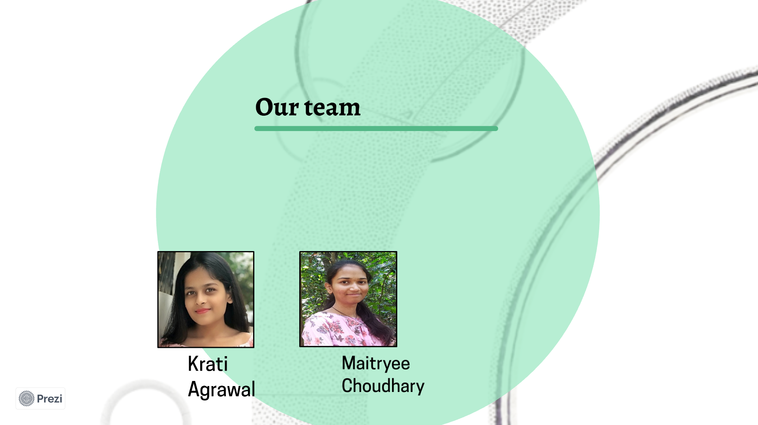
TEAM-7

Slide 3
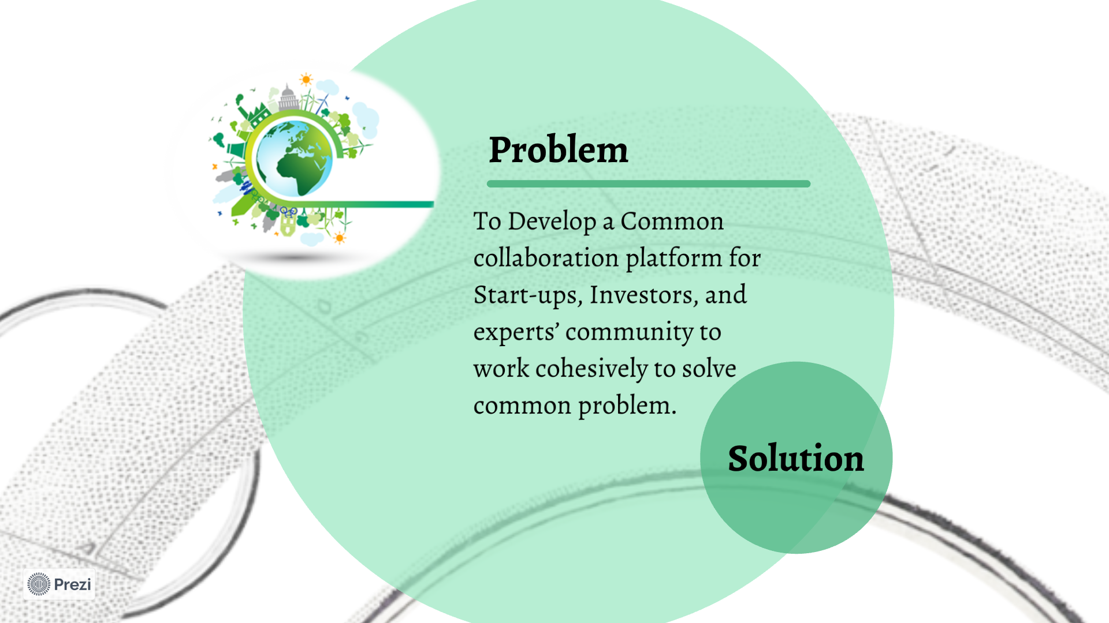
TEAM-7

Slide 4

TEAM-7

Slide 5

TEAM-7

Slide 6
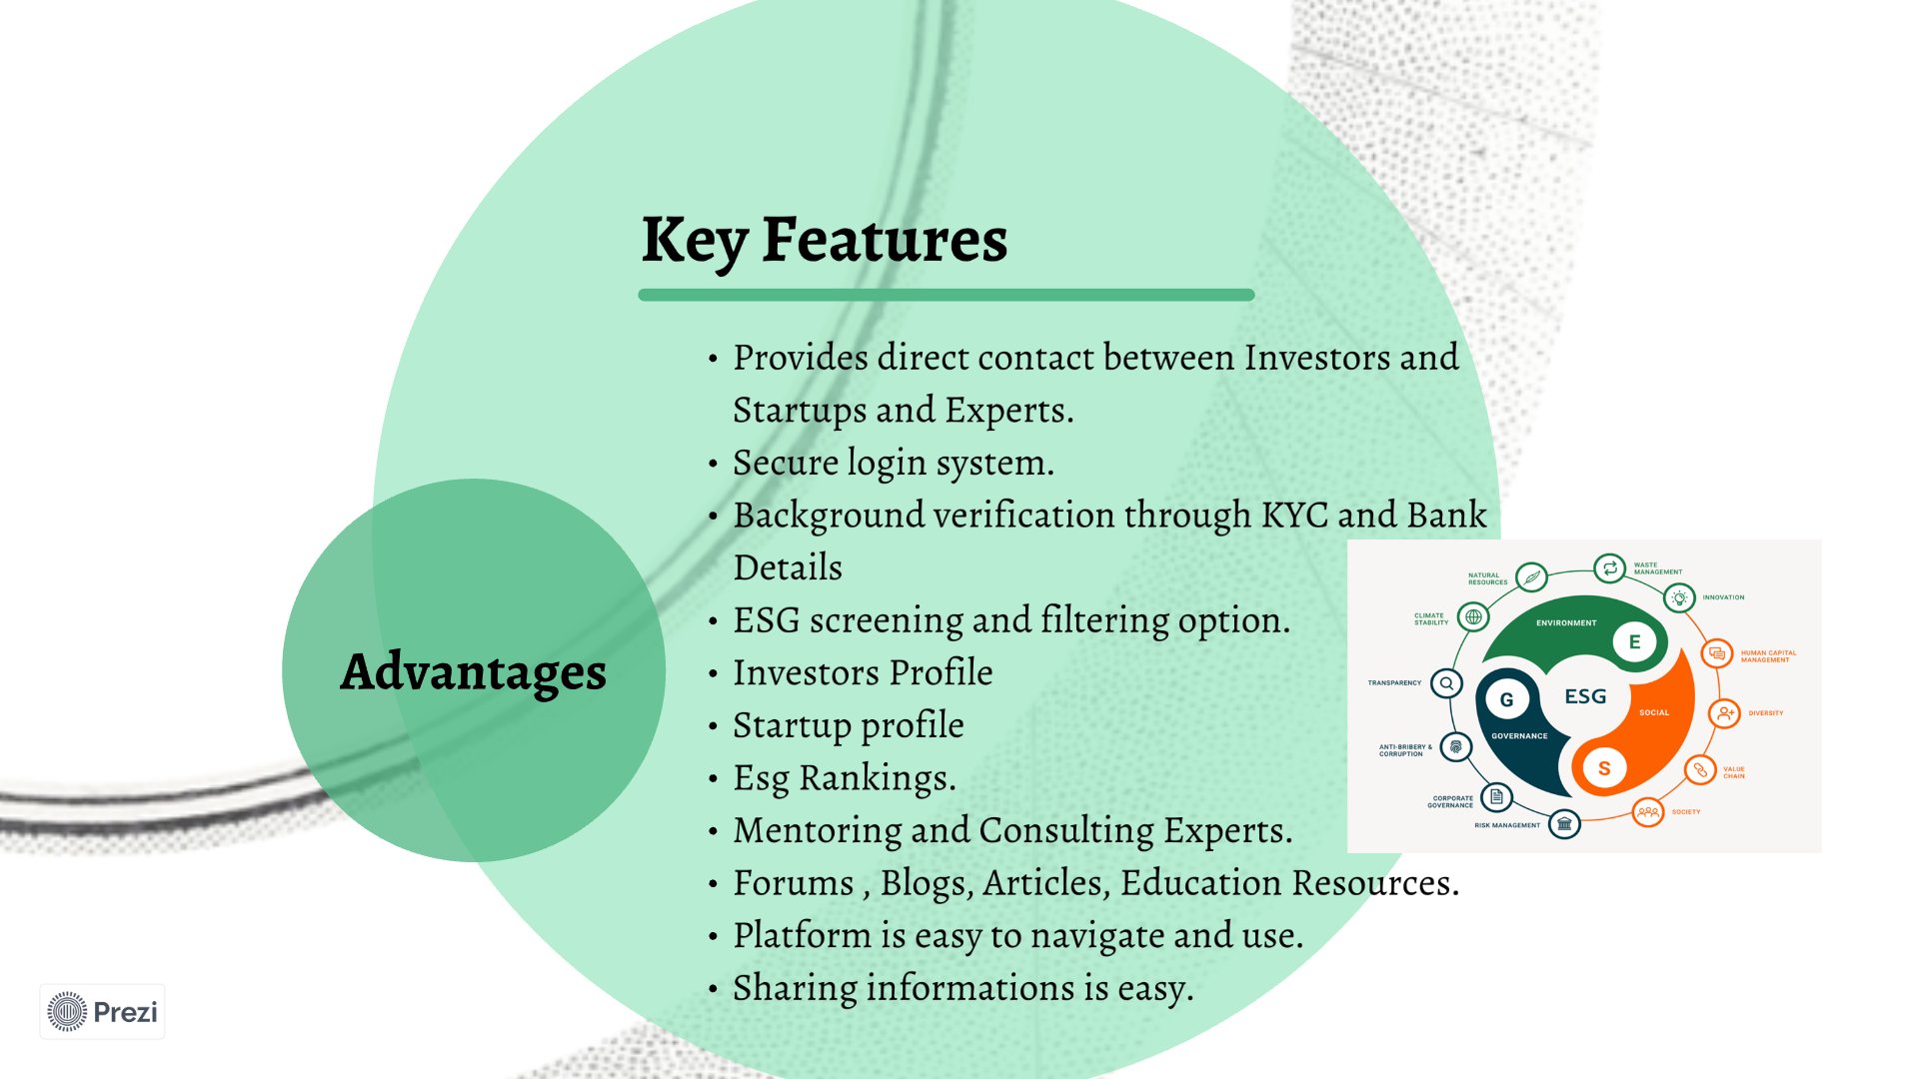
TEAM-7

Slide 7
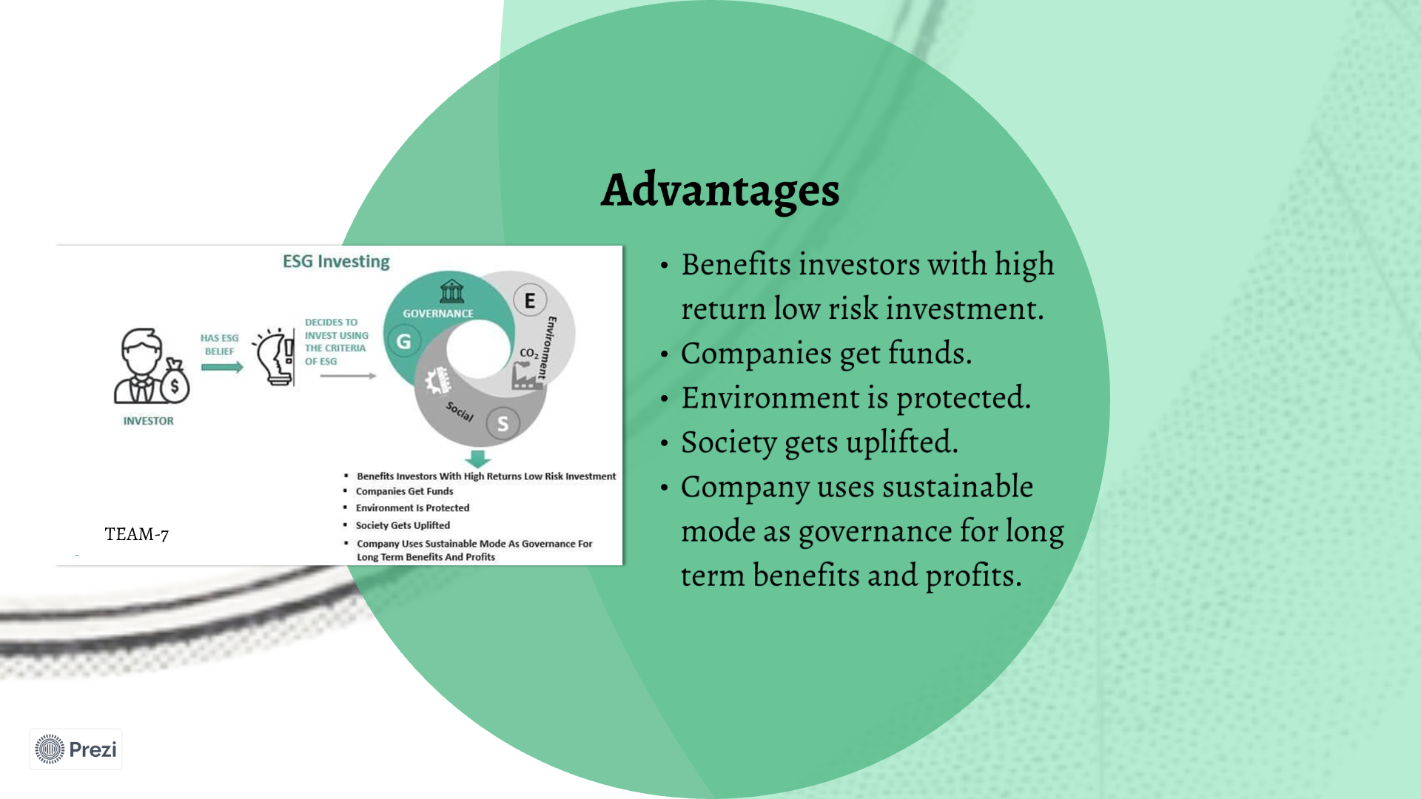
TEAM-7

Slide 8
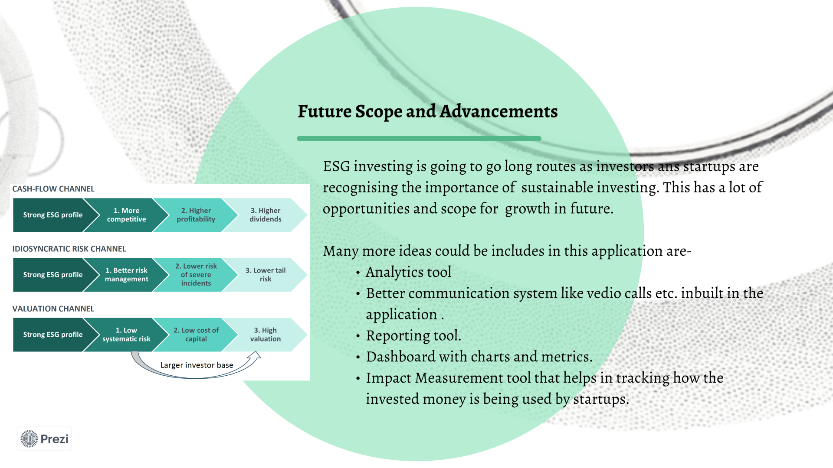
TEAM-7

Slide 9
TEAM-7

